Slide 1
To Remember
When I receive Jesus in Holy Communion I talk to him in my own words and thank him for coming to me.

Slide 2
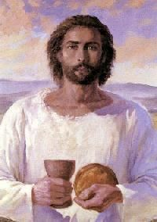
God’s Work
“It is the deep belief of the Church that no one comes to faith, to the Church, to the sacraments or even to God without their being called by God. This is God’s work, not ours. God initiates, God calls, God converts. We cooperate with initiatives of God. We respond. What is being celebrated is that God is indeed calling a person into the life of the Church and the sacraments as initiation into life.”
(Terry Wade ed. The parish companion to the Rite of Christian Initiation of Adults, 42.)

Slide 3
Father in heaven,
you have called us to receive the
Body and Blood of Christ at this table
and to be filled with the joy
of the Holy Spirit.
Through this sacred meal
give us strength to please you
more and more. Eucharistic Prayer for Children III

